Slide 1
2015 GTTP PHOTO CONTEST
TOP ENTRIES

Slide 2
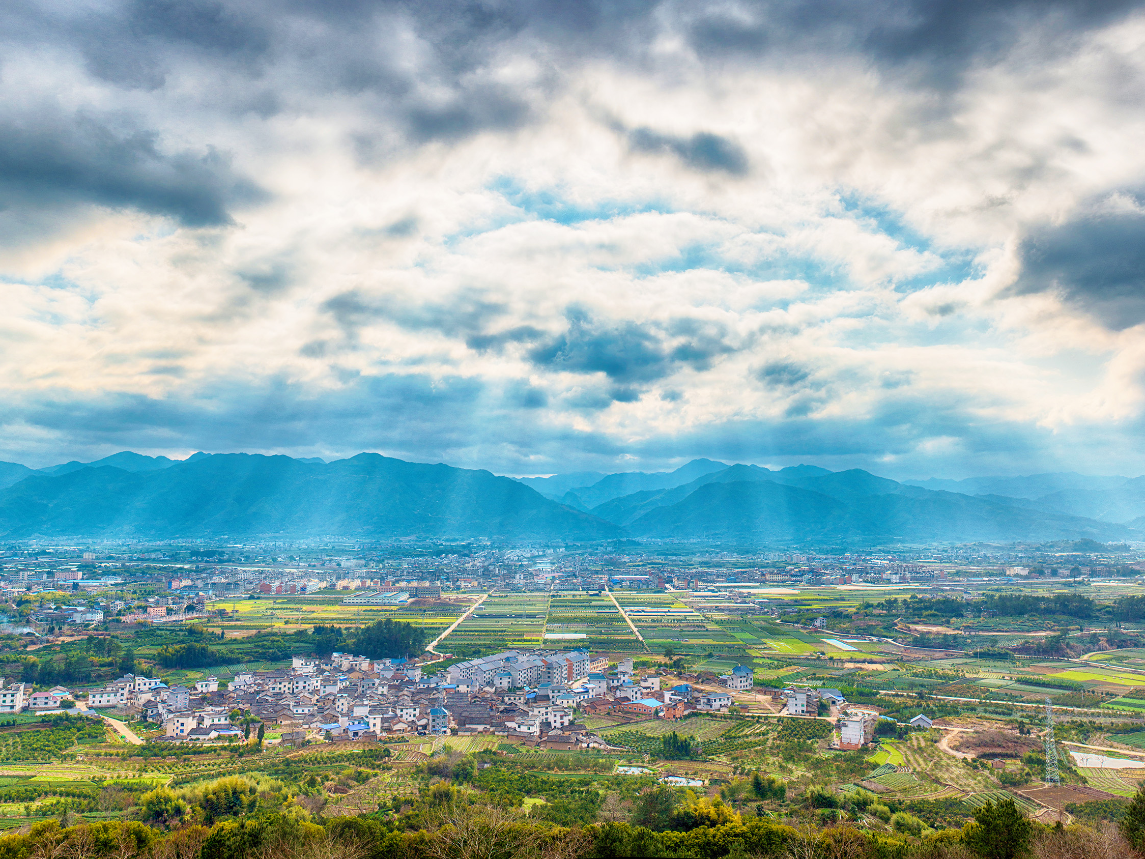
HUANG DONGBO, CHINA
The ancient city of Songyang, Zhejiang Province
Huang Dongbo of China managed to capture skillfully a brief moment when the scene was illuminated by rays of sunlight, then used a little digital enhancement to create this vista of city, fields and mountains.

Slide 3
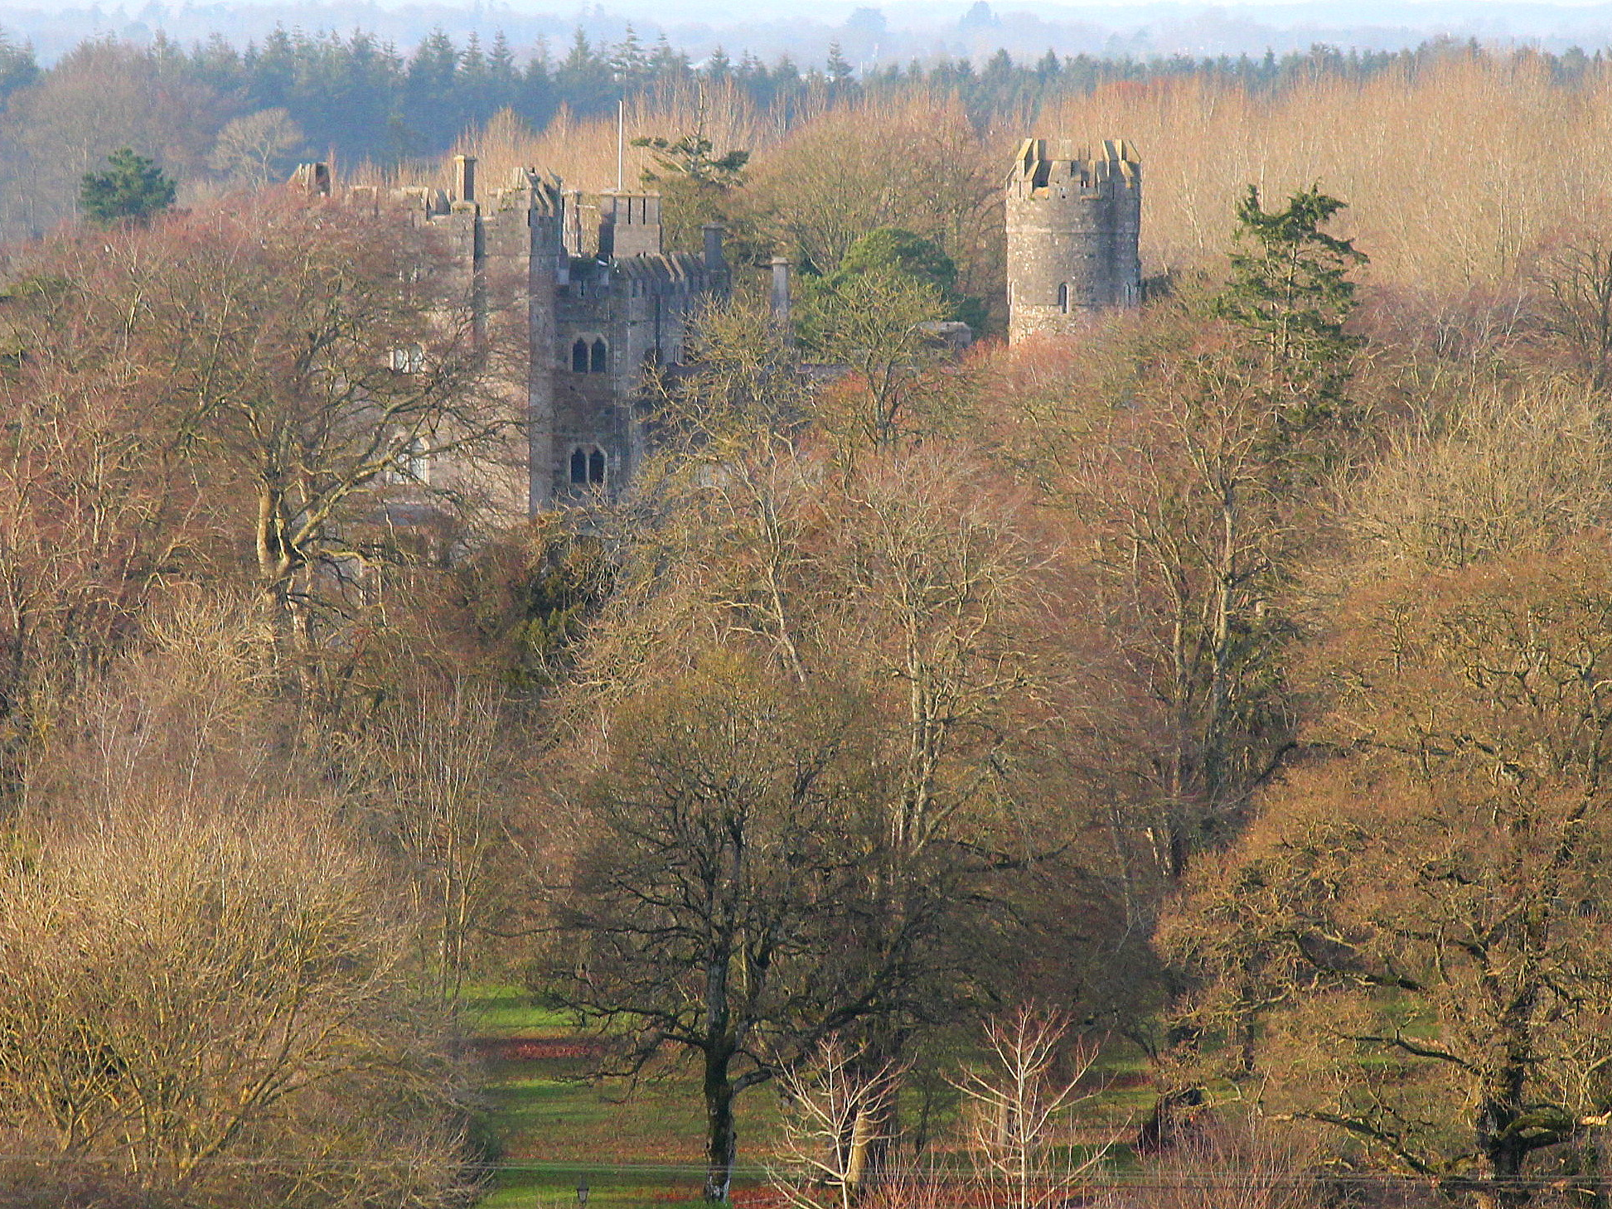
ANTHONY O'SHAUGHNESSY, IRELAND
Hidden History
Anthony O’Shaughnessy of Ireland made good use of the trees in order to focus our eyes on the castle

Slide 4
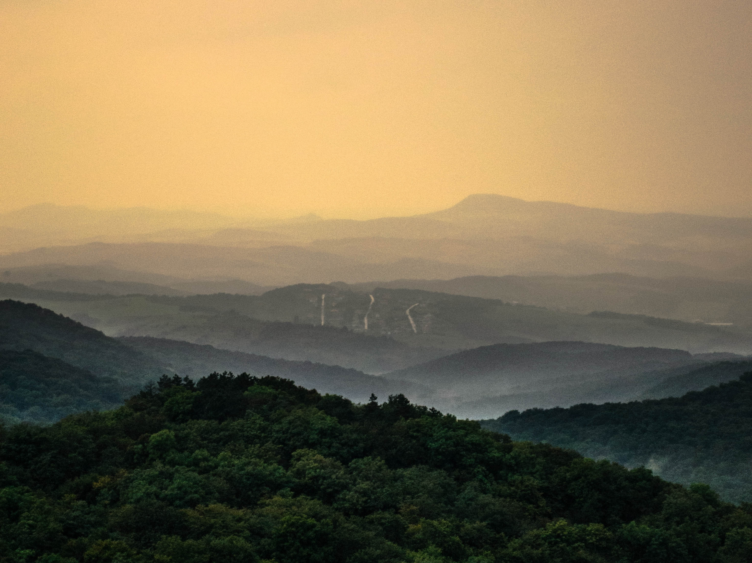
DUDAS REGINA, HUNGARY
Heavenly layers, the Nagy-Szénás Hills in Hungary
Dudas Regina made good use of the vantage point and of the light to emphasize the dark tree mass in the forground,and the soft light in the distance.

Slide 5
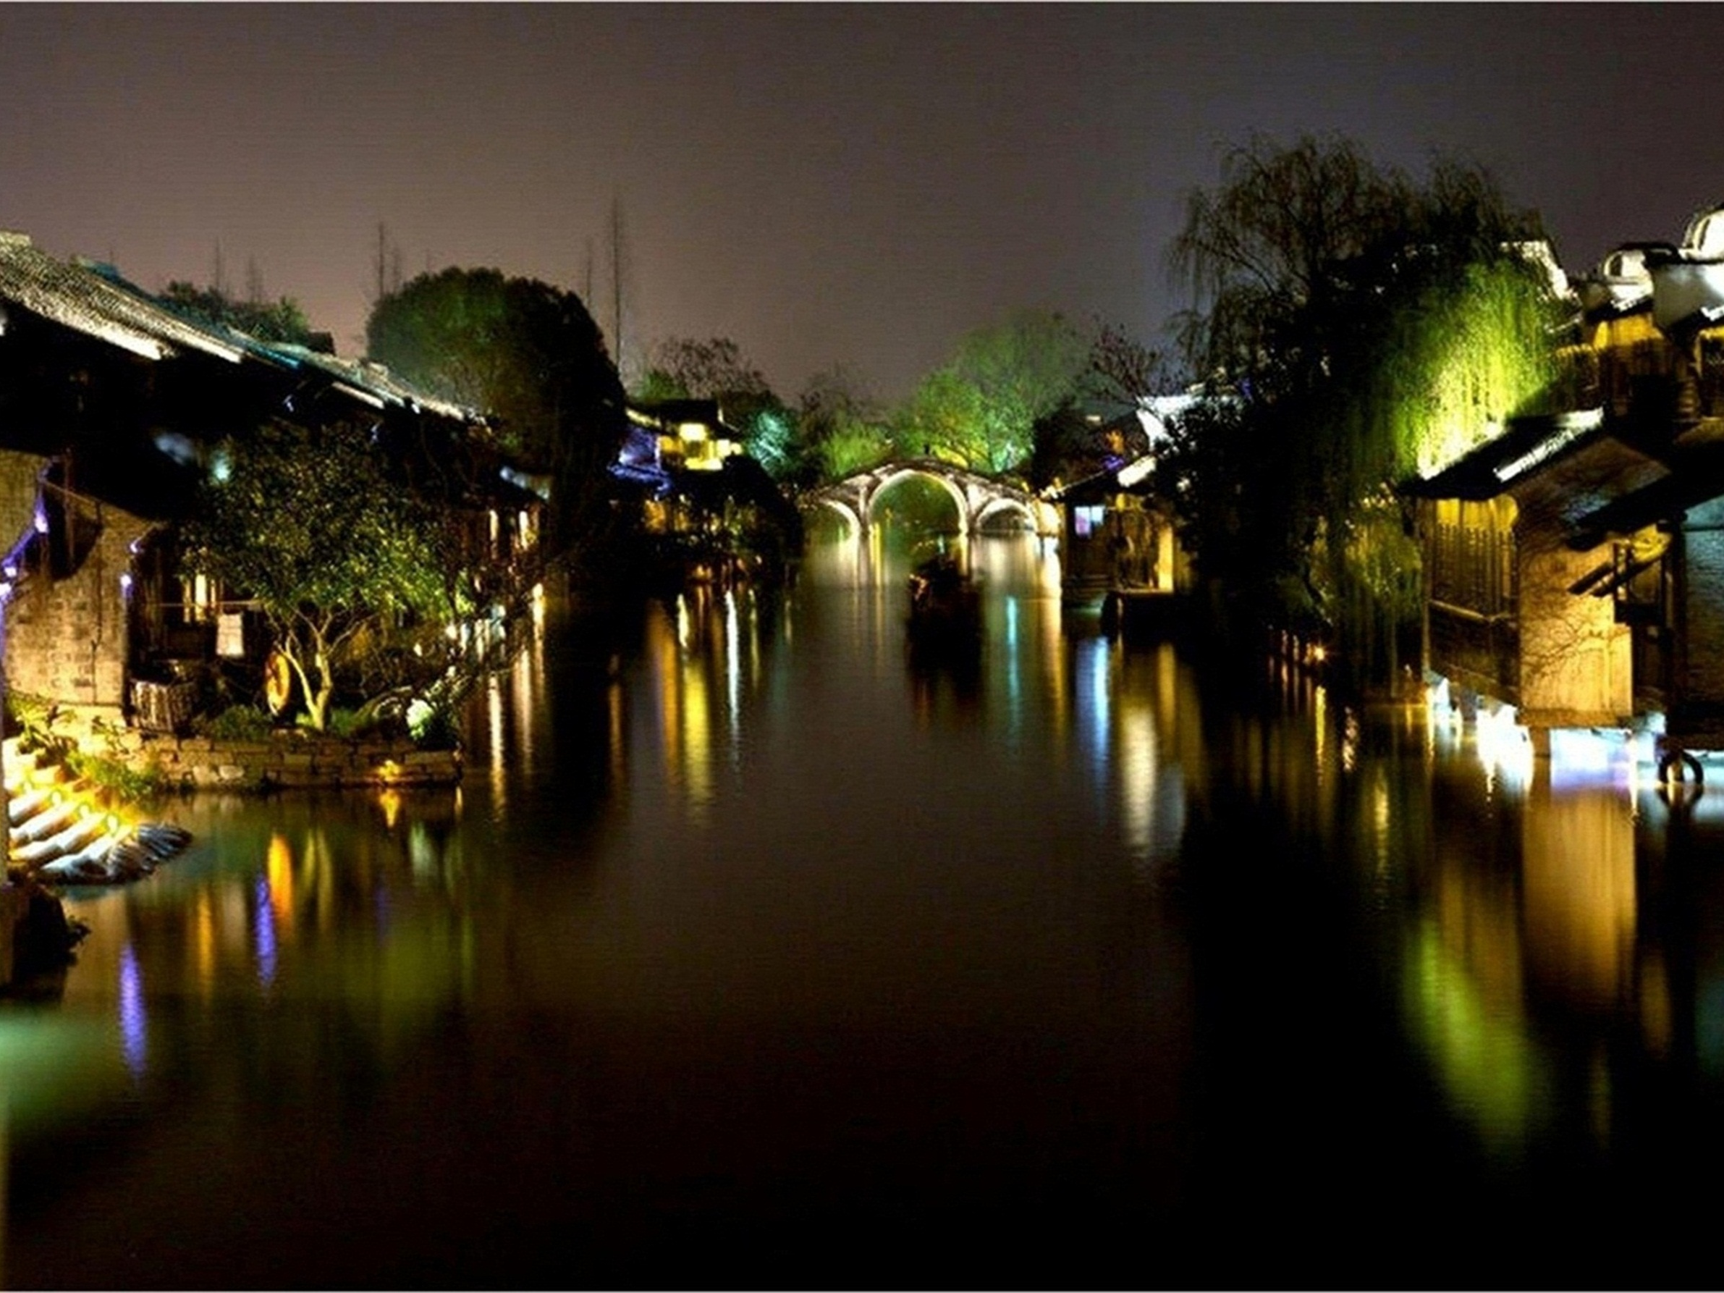
PENG DANLI, CHINA
Come, and never leave Wuzhen Town, Zhejiang Province
This image certainly encourages you to explore Wuzhen Town. Peng Danli of China clearly was trying to balance the mystery created by pools of light and darkness with the temptation to reduce the darkness so we could see more detail.

Slide 6
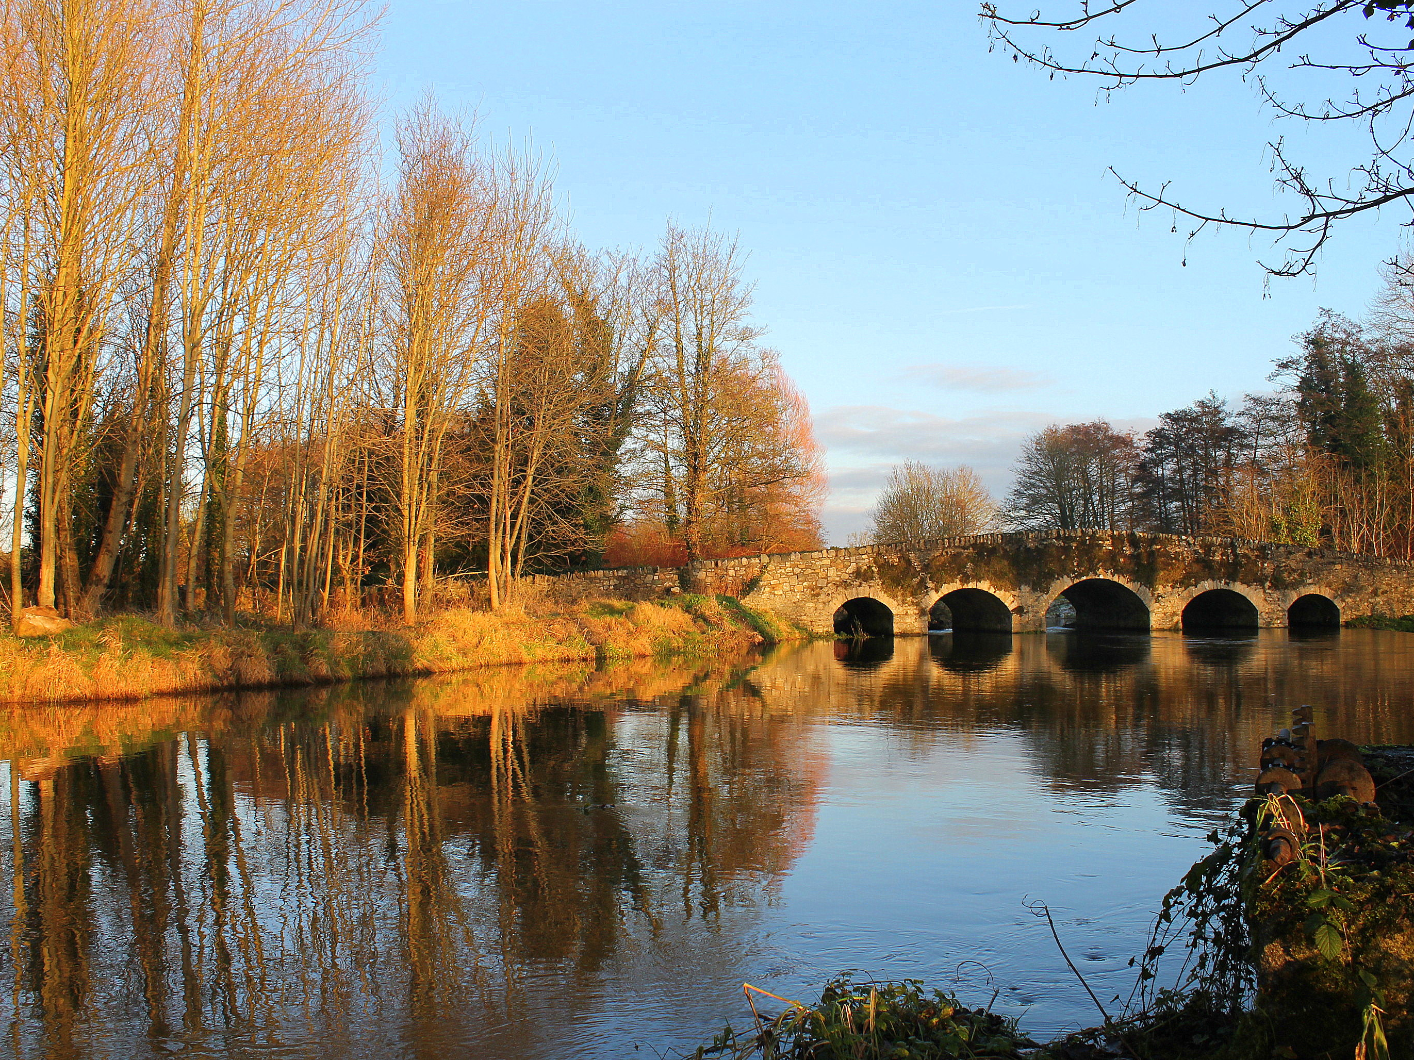
SENAN KELLY, IRELAND
Bridge over still waters
Senan Kelly has created a classic image of water, an 18th century bridge, and Autumn

Slide 7
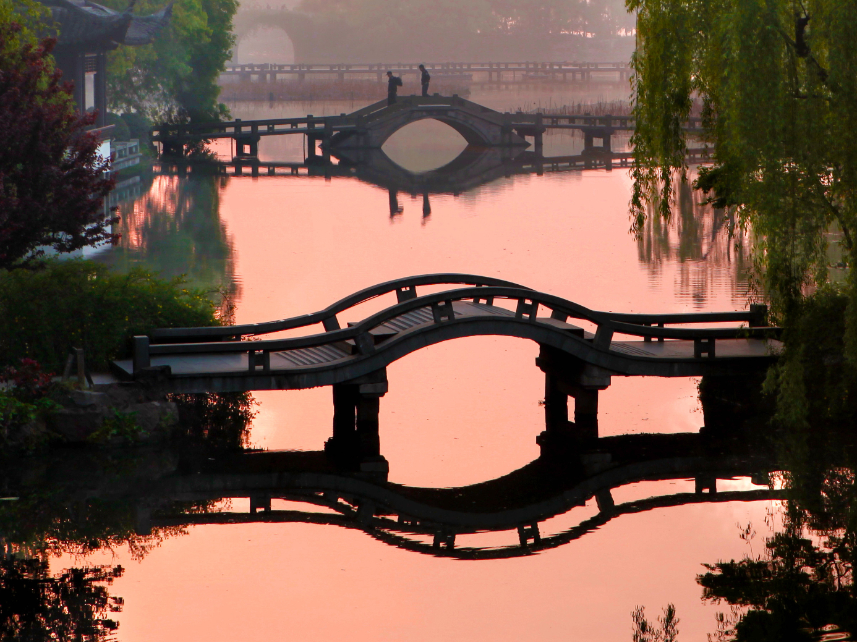
ZHENG SHUHUA, CHINA
Sunset on the West Lake
Zheng Shuhua took skillful advantage of the reflecting surface of the water and the bridges.

Slide 8
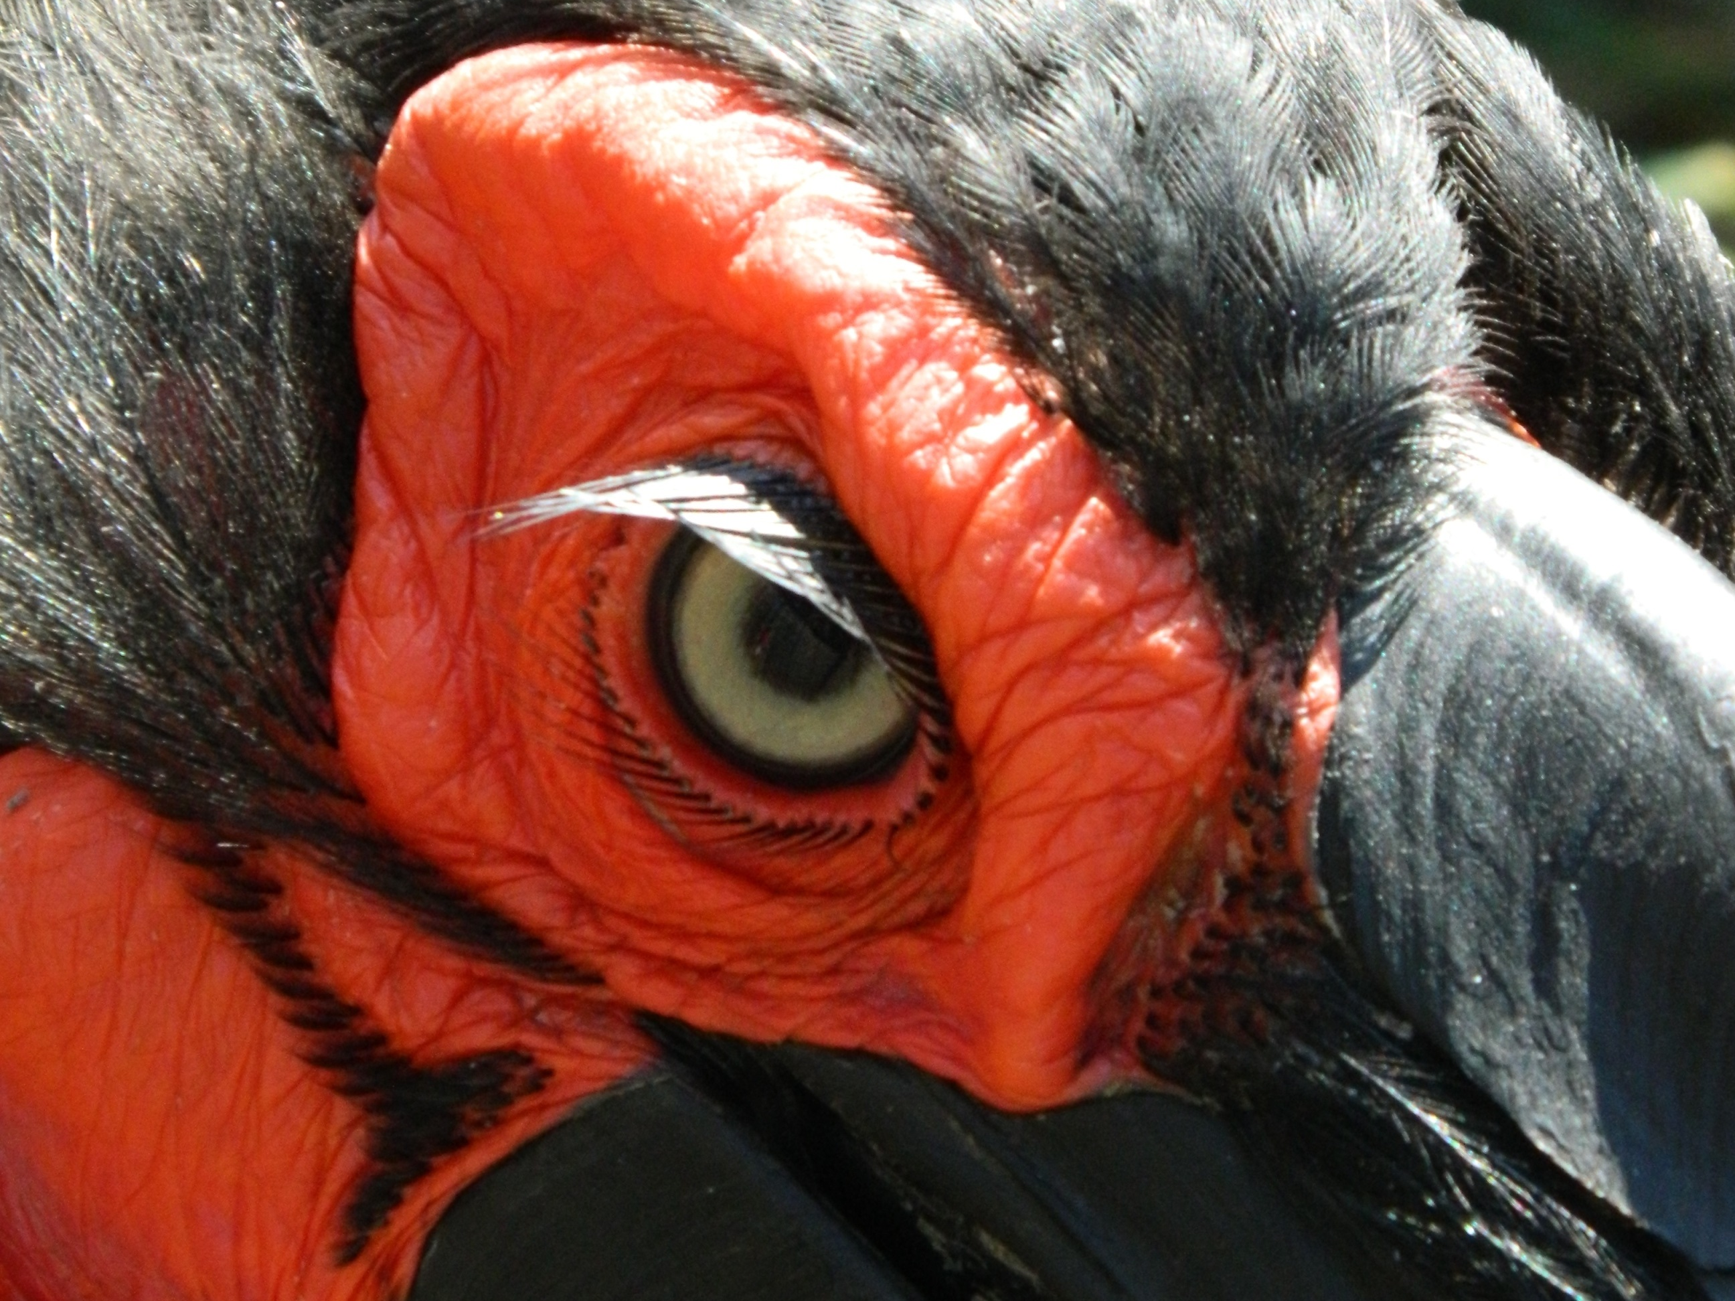
BIANCA BENADE, SOUTH AFRICA
Southern Ground-Hornbill, Kruger National Park
Bianca Benade of South Africa has created a carefully composed image that offers fine details of eye, skin and feathers that combine to suggest a creature with a strong personality

Slide 9
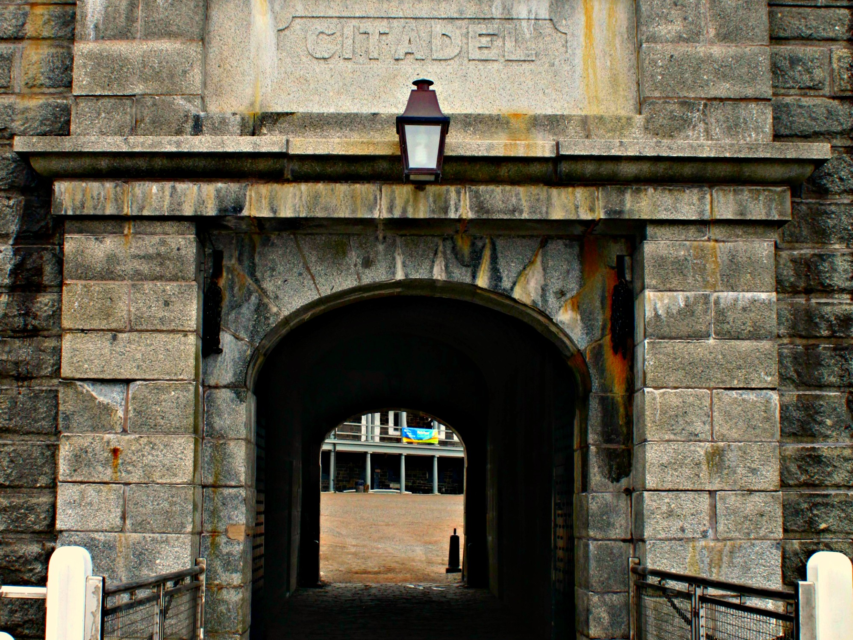
TRISHA LEE, CANADA
We invite you to enter the Halifax Citadel national historic site
By framing the interior courtyard within the Citadel’s dark entry-way Trisha Lee of Canada guides the viewer’s eye.

Slide 10
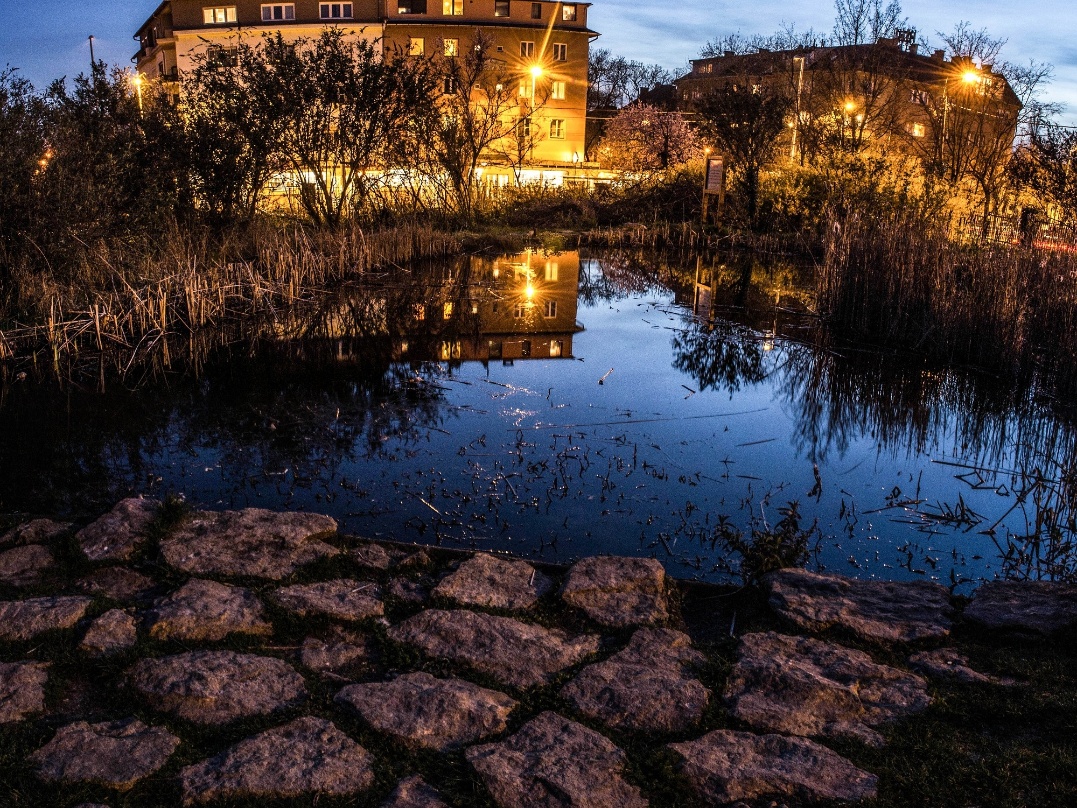
DUDAS VAJK, HUNGARY
Inner city Budapest fish pond
Dusk, bright lights, shadows and reflections are captured in a single image by Dudas Vajk of Hungary.

Slide 11
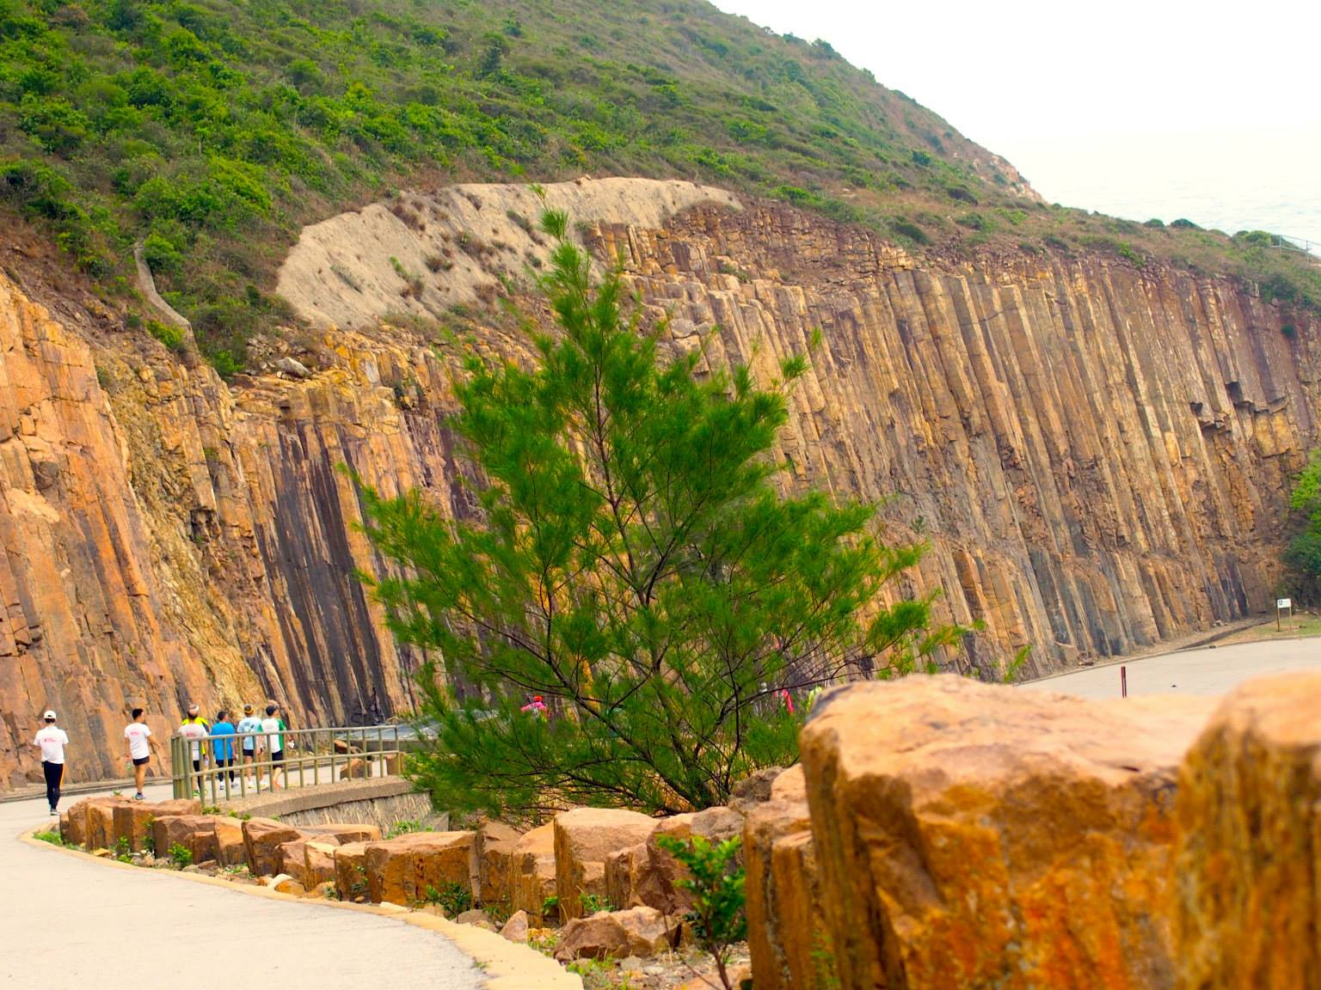
SO WING HANG
Hexagonal rock columns, Sai Kung Geopark, Hong Kong
So Wing Hang of Hong Kong has used the contrasting textures of vegetation and rock plus a little digital color saturation to capture a striking geological formation.

Slide 12
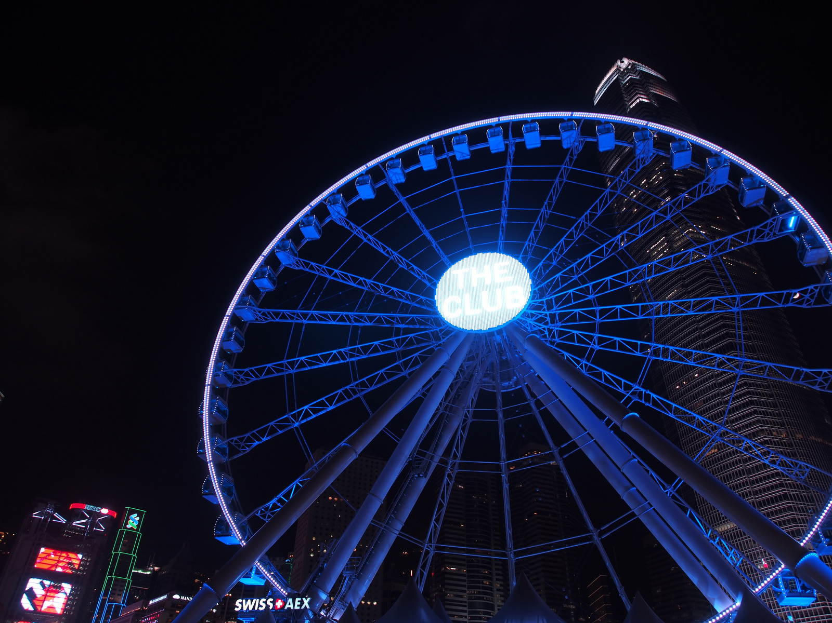
LAM YUK YU, HONG KONG
Night view, Hong Kong Observation Wheel, Waterfront Promenade
Lam Yuk Yu of Hong Kong by the carefully cropping and placement of the Observation Wheel has created a colorful abstract design.

Slide 13
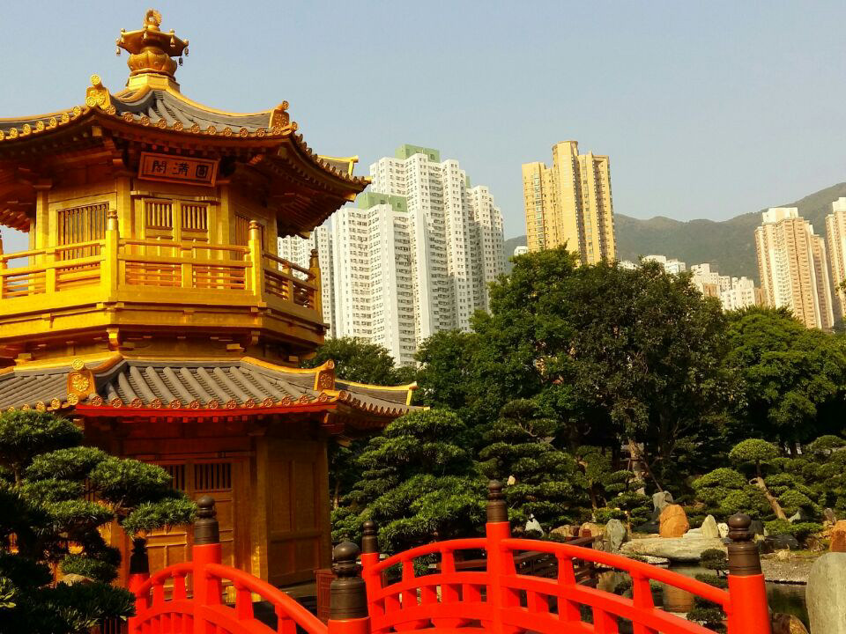
SING KA HIN KEVIN, HONG KONG
Old style Chinese pagoda, Nan Lian Garden, and public housing estates, Hong Kong
Sing Ka Hin (Kevin) of Hong Kong contrasts the city’s old and new faces in this careful composition.

Slide 14
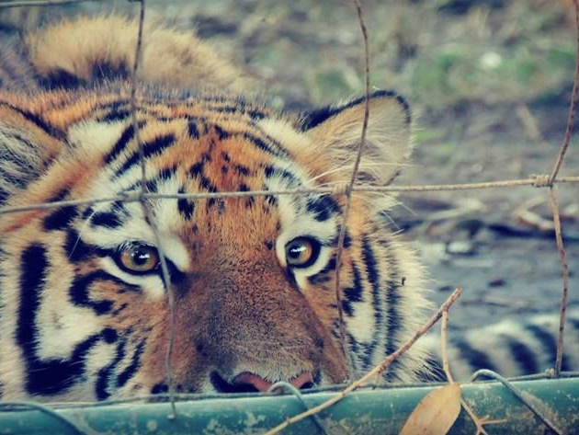
BIANCA-LEE NABAL, SOUTH AFRICA
Tiger, tiger burning bright
Bianca-Lee Nabal of South Africa uses cropping to focus our eyes on the way the tiger looks at the world from its cage.

Slide 15
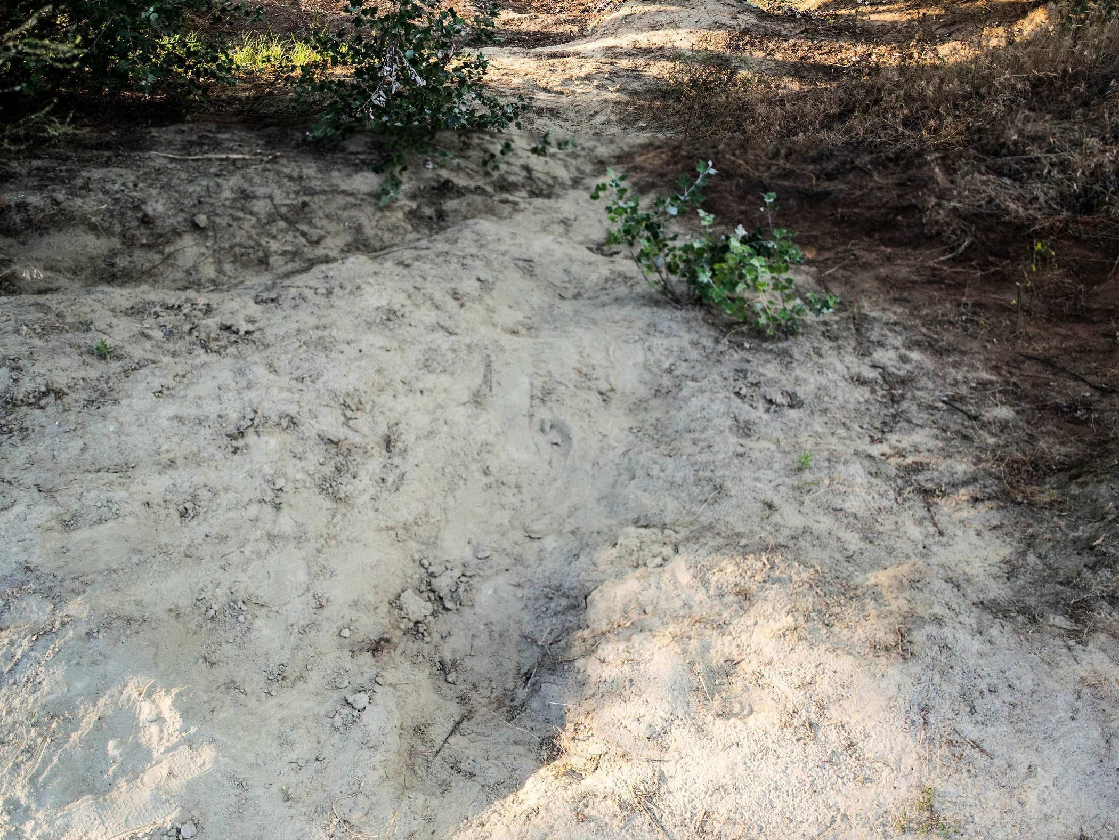
DUDAN VAJK, HUNGARY
Lupa pond, an abandoned sand mining site that is now an open resort area in Budapest
Dudan Vajk of Hungary introduces vistors to Budapest to an interesting site in his city.

Slide 16
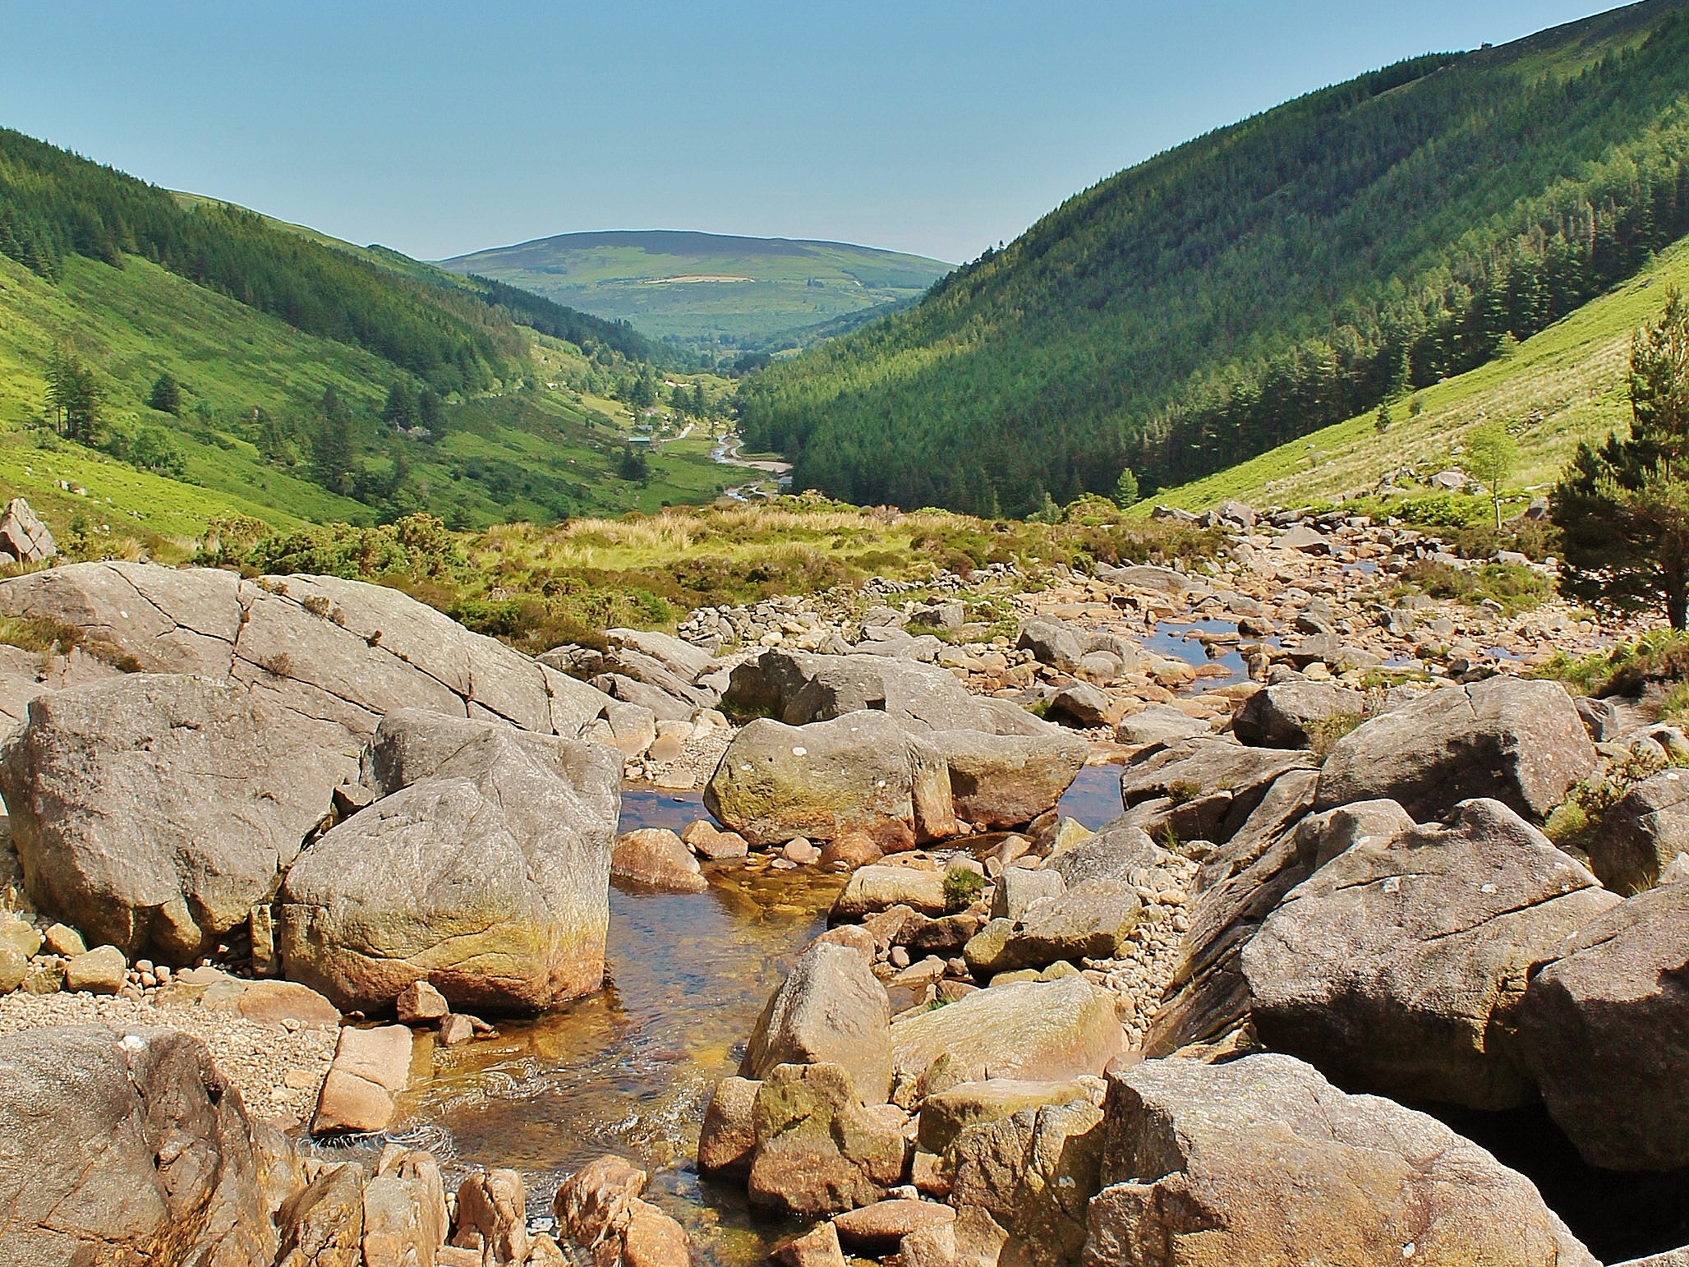
ADAM BURKE, IRELAND
Rocky River Runs or Flows
Adam Burke of Ireland uses the geology of the valley to frame and direct our eyes from the foreground and its boulders to the hill in the distance.

